Slide 1
Lecture 19
JavaScript

Slide 2
Previous Lecture
ECMA (European Computer Manufacturer's Association)
Coders commonly use ECMAScript for client-side scripting on the World Wide Web, and it is increasingly being used for writing server applications and services using Node.js

Slide 3
Today’s Lecture
Transpilers
Getting started with React

Slide 4
Transpilers
A transpiler is a tool which takes a source code of a given language and translates it into another language.
Example>
Writing a code in TypeScript and convert it into JavaScript.

Slide 5
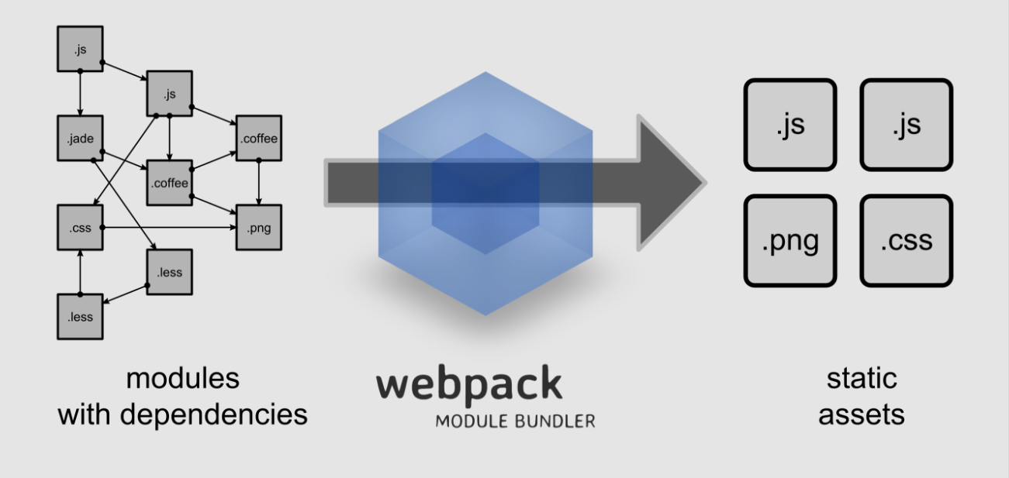
Webpack
A popular tool which can take your pre-ready assets and converts them into static assets.

Slide 6
Webpack
It loads all the module dependencies and merge them into a single asset unit which has a number of benefits:
1). It loads automatically the used modules
2). Decreases loaded time

Slide 7
Webpack
Installing Webpack>
npm install –g webpack

Slide 8
Webpack
Source
Destination

Slide 9
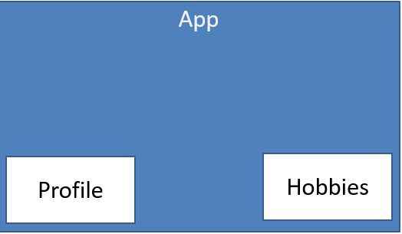
Lets React!

